Slide 1
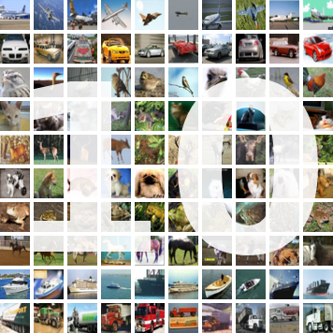
DEEP LEARNING: CIFAR10
CHABCHOUB aymen - LAMA Graih Jules - MALONGA-NKOUNKOU Gautier - OUMESSAOUD Rabah

Slide 2
Presentation of Cifar 10
CIFAR stands for: Canadian Institutes For Advanced Research
collection of images that are commonly used to train machine learning and computer vision algorithms.
The dataset is composed of 10 classes:
cars, trucks, airplanes, ships
deer, dogs, cats, birds, horses, frogs

Slide 3
The dataset in theory
The CIFAR-10 dataset consists of 60000
32x32 colour images
6000 images per class
50000 training images
10000 test images
The classes are completely mutually exclusive

Slide 4
The dataset in practice
5 pickled files
data
labels
label_names
data:
10000 x 3072 numpy array
10000 is the number of images
3072 = 32*32*3(channels)
Labels:
list of 10000 numbers between 0-9.
label_names:
string list with label names (size 10)

Slide 5
Dataset: conclusion
Small dataset: fits in the ram!
Efficient for quick learning and fine tuning
Classes are not skewed

Slide 6
Linear models
3072 pixels for the input
activation function: linear
10 classes for the input with Softmax activation function
optimizer: Adam
3072 pixels for the input
activation function: TanH
10 classes for the input with Softmax activation function
optimizer: Adam

Slide 7
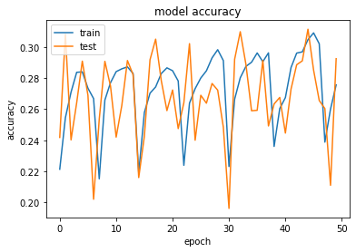
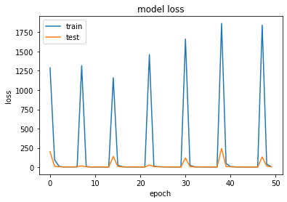
Linear model v1

Slide 8
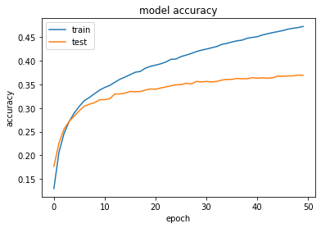
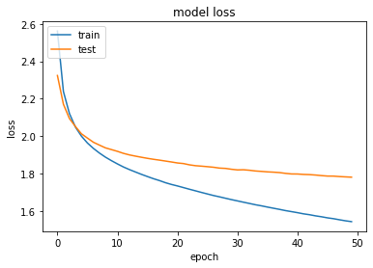
Linear model v2

Slide 9
Linear models: conclusion
The model’s predictions won’t improve by just tuning the hyperparameters
Adding layers allows predicting more complex functions
Different optimizer allow faster model converging

Slide 10
Feed forward models
3072 pixels for the input
activation function: reLu
2 hidden layers (1040)
10 classes for the input with Softmax activation function
optimizer: Adadelta
This model is close to our Linear model V2

Slide 11
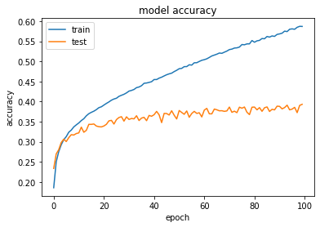
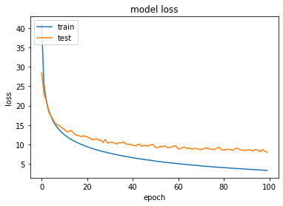
Feed forward v1

Slide 12
Feed forward: regularizer 0.01

Slide 13
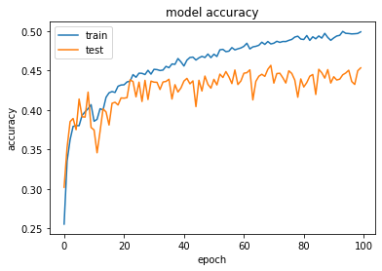
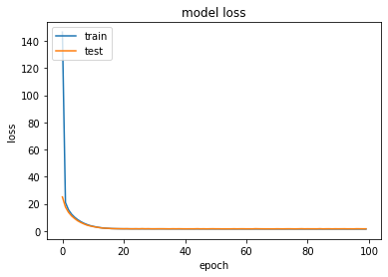
Feed forward: regularizer 0.05

Slide 14
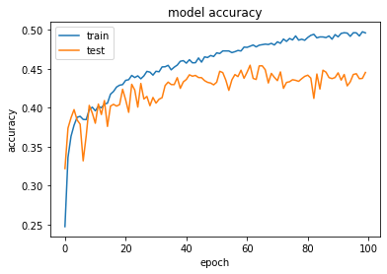
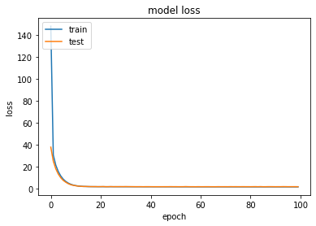
Feed forward: regularizer 0.1

Slide 15
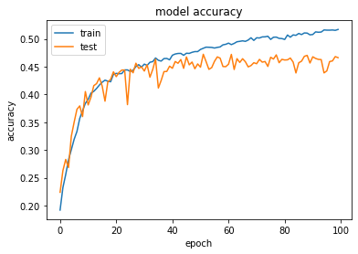
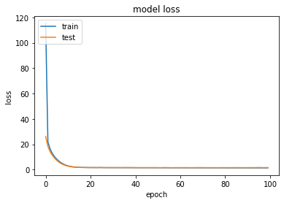
Feed forward: regularizer 0.05 + dropout 0.1

Slide 16
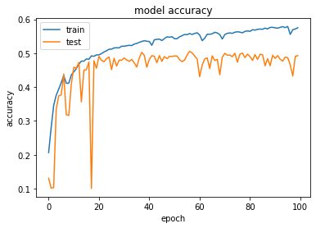
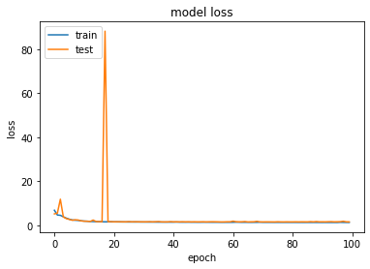
Feed forward: regularizer 0.05 + dropout 0.2 + BatchNormalization

Slide 17
Feed forward models
3072 pixels for the input
activation function: reLu
5 hidden layers
10 classes for the input with Softmax activation function
optimizer: Adam

Slide 18
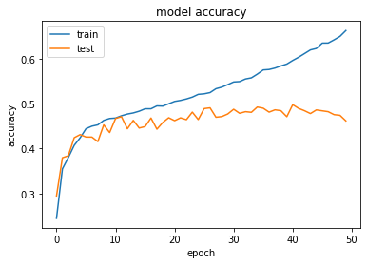
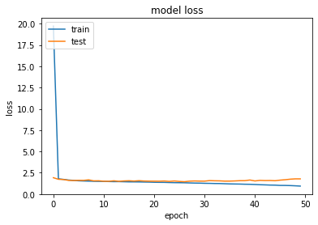
Feed forward: no regularization

Slide 19
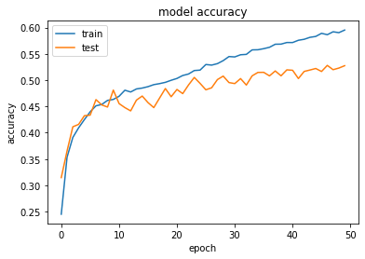
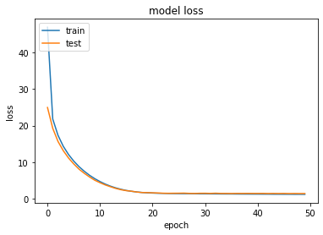
Feed forward: regularization 0.1

Slide 20
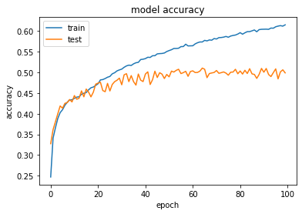
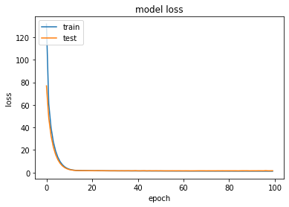
Feed forward: regularization 0.05

Slide 21
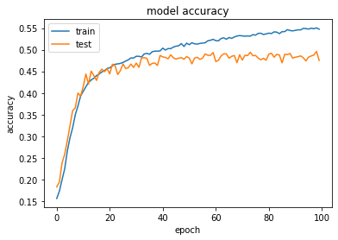
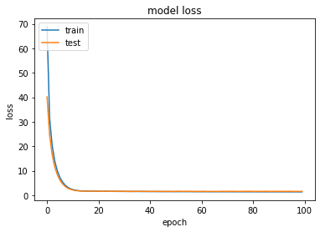
Feed forward: regularization 0.1 + dropout 0.1

Slide 22
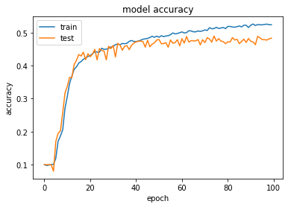
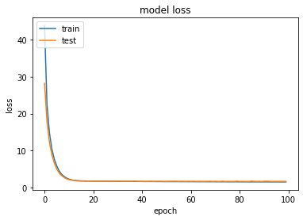
Feed forward: regularization 0.1 + dropout 0.2

Slide 23
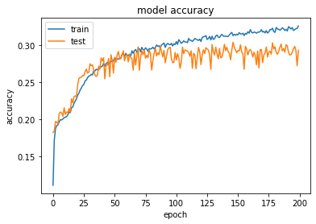
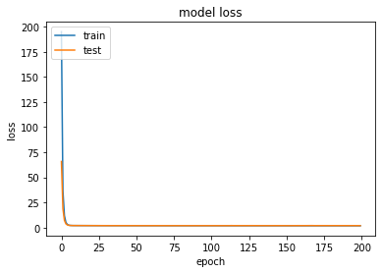
Feed forward: regularization 0.1 + dropout 0.2
lr 0.001

Slide 24
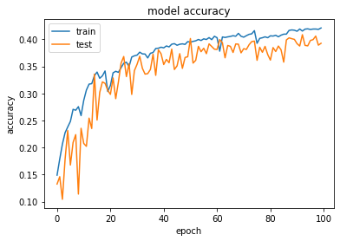
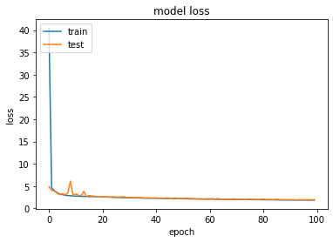
Feed forward: regularization 0.1 + dropout 0.2
1 layer (6 dense)

Slide 25
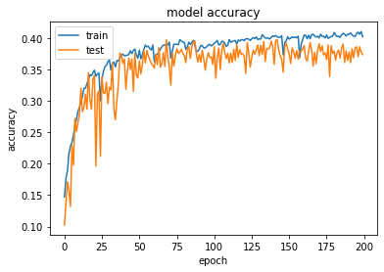
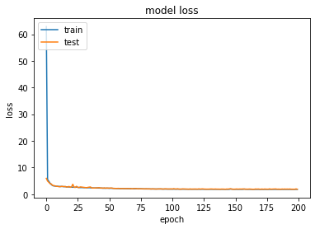
Feed forward: regularization 0.1 + dropout 0.2
1 layer + lr 0.001

Slide 26
Convolutional neural network
32,32,3 input shape
activation function: reLu
kernel_size: 3,3
filters: 32
2 hidden layers: 1040 neurons
10 classes for the input with Softmax activation function
optimizer: Adam

Slide 27
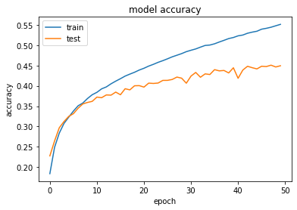
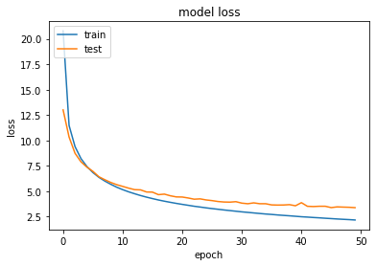
CNN

Slide 28
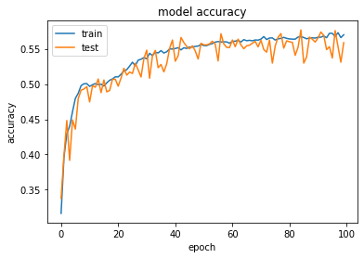
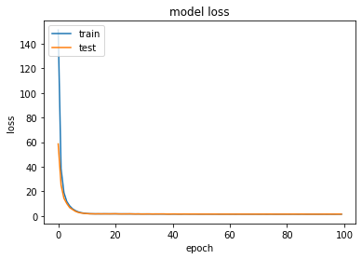
CNN + regularization: 0.1

Slide 29
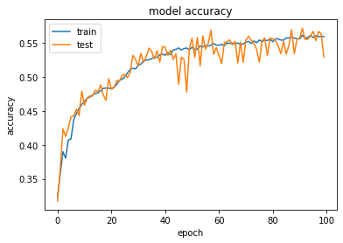
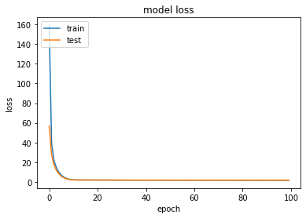
CNN + regularization: 0.1 + filters: 64

Slide 30
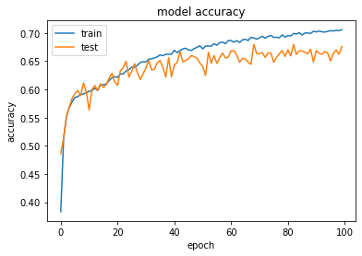
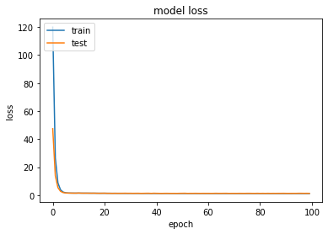
CNN(2conv) - regularization: 0.1 - filters: 32/64

Slide 31
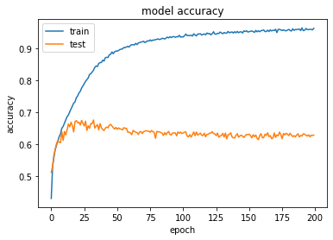
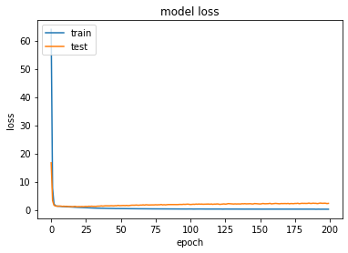
CNN(3conv) - regularization: 0.1
- filters: 32/64/128

Slide 32
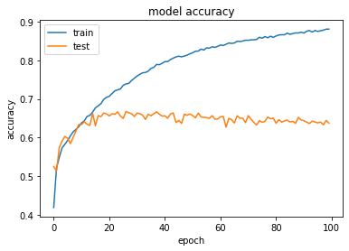
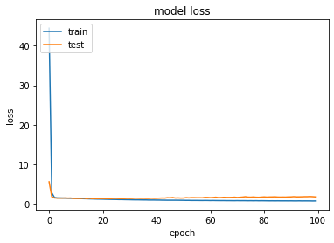
CNN(3conv) - regularization: 0.1
- filters: 32/64/128 - dropout 0.2

Slide 33
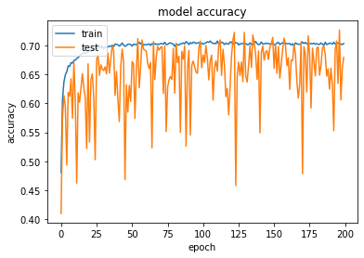
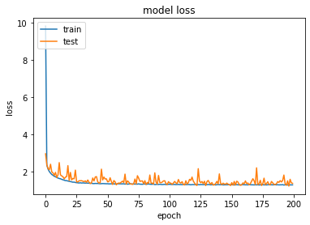
CNN(4conv) - regularization: 0.1
- filters: 32/32/64/64 - dropout 0.2
LR: 0.001

Slide 34
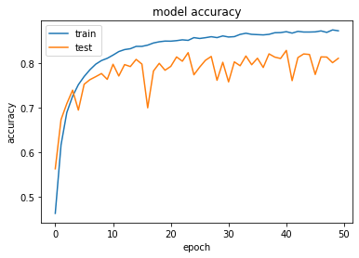
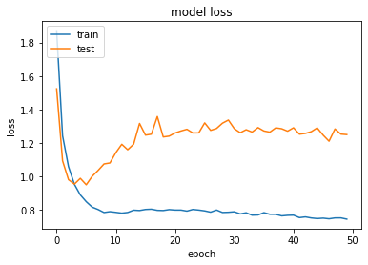
CNN(4conv) - regularization: 0.0001
- filters: 32/32/64/64 - dropout 0.2
LR: 0.001

Slide 35
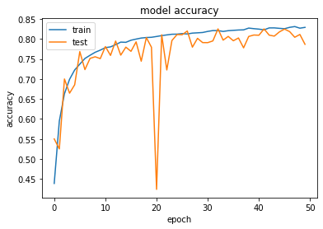
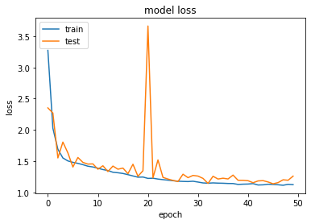
CNN(4conv) - regularization: 0.001
- filters: 32/32/64/64 - dropout 0.4
LR: 0.001

Slide 36
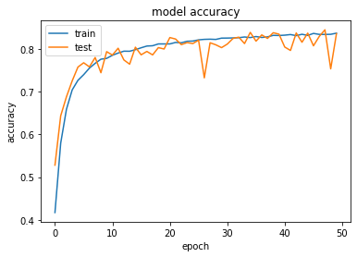

CNN(4conv) - regularization: 0.001
- filters: 32/32/64/64/128/128 - dropout 0.4
LR: 0.001

Slide 37


CNN(4conv) - regularization: 0.001
- filters: 32/32/64/64/128/128/256/256 - dropout 0.4
LR: 0.001

Slide 38
Residual neural network
Convolution block
Residual block
1 or 2 hidden layers
10 classes for the input with Softmax activation function
optimizer: Adam

Slide 39


Resnet: 10 residual layers

Slide 40


Resnet: 15 residual layers
L2 regu: 0.001

Slide 41


Resnet: 15 residual layers
L2 regu: 0.001 + dropout 0.4 + 2 dense

Slide 42


Resnet: 4 conv blocks + 12 residual layers
L2 regu: 0.001 + dropout 0.4 + 1 dense 512

Slide 43


Resnet: 4 conv blocks + 12 residual layers
L2 regu: 0.001 + dropout 0.4 + 1 dense 1024

